Slide 1

SAPIENZA UNIVERSITY OF ROME
Faculty of Information Engineering, Computer Science and Statistics • ACSAI • A.Y. 2025/2026
Seismic Viewer
Design, Implementation and Evaluation of an Interactive 4D Spatio-Temporal Visualisation System for Seismological Data
Candidate
Academic Supervisor
Co-Supervisor
Alessio Curcio
Prof. Danilo Avola
Dr. Daniele Bailo
ID: 2120317
Notes:
[SLIDE 1 | TIME: 0:00 - 0:35 | TARGET: 35 SECONDS]
SPEECH (EN):
"Hello everyone.
My name is Alessio Curcio, and today I'm glad to present my internship report titled:
'Seismic Viewer: Design, Implementation and Evaluation of an Interactive 4D Spatio-Temporal Visualisation System for Seismological Data'.
This work was carried out during my curricular internship at the National Institute of Geophysics and Volcanology."
[VISUAL ACTION: Smile, welcome the committee, make eye contact, project confidence, advance to Slide 2 at 0:35]

Slide 2



DOMAIN CONTEXT & RESEARCH MOTIVATION
The Campi Flegrei Volcanic Challenge
Active Volcanic Unrest
Planar Fault Structures
INGV Operational Need
Ongoing bradyseismic uplift and dense swarm seismicity since 2005 demand continuous, multi-parametric spatial monitoring.
Recent studies (Giordano, Alfonsi et al., Nature Comm. 2025) demonstrate that hypocentres delineate growing planar faults rather than diffuse isotropic clusters.
Geophysicists require an interactive desktop system bridging raw catalogues, tomography models, and automated fault plane extraction.
Notes:
[SLIDE 2 | TIME: 0:35 - 1:20 | TARGET: 45 SECONDS]
SPEECH (EN):
"To understand why we started this project, we have to look at what's happening right now at the Campi Flegrei volcanic caldera near Naples.
Since 2005, this area has been experiencing active bradyseism — meaning continuous ground uplift accompanied by frequent, intense earthquake swarms.
Just recently, in 2025, a study published in Nature Communications Earth & Environment, co-authored by researchers from INGV and Roma Tre University, made an important discovery: these earthquakes aren't just random noise. Instead, they clearly delineate the pressurization of hydrothermal fluids and the physical growth of an active underground fault plane.
However, geophysicists had a major problem: they lacked an interactive tool to explore and track these faults in 3D and 4D over time. That's exactly why Seismic Viewer was proposed."
[VISUAL ACTION: Point to Campi Flegrei context on Card 1, highlight the 2025 Nature study on Card 2, then point to Card 3]

Slide 3
STATE OF THE ART & TOOLING COMPARISON
Bridging the Seismological Visualisation Gap
GIS PLATFORMS
SCIENTIFIC CODE
OUR SOLUTION
QGIS & ArcGIS
ObsPy & GMT
Seismic Viewer
2D Projection Bias: Flattens depth dimension into 2D maps.
Static Figures: Produces batch PNG/PDF plots without interaction.
Interactive 4D: WebGL GPU rendering across space and time.
3D Latency: Frame drops with dense hypocentral point clouds.
Steep Curve: Requires constant command-line scripting.
Fault Plane Fitting: Automated RANSAC + SVD extraction.
No Time Playback: Lacks integrated 4D fault plane tracking.
Isolated Steps: No real-time geometric model fitting.
Sub-Second Response: Float32 binary streaming protocol.
Notes:
[SLIDE 3 | TIME: 1:20 - 2:00 | TARGET: 40 SECONDS]
SPEECH (EN):
"When we looked at the tools seismologists currently use, we found a clear technological gap:
First, standard GIS tools like QGIS or ArcGIS are great for 2D cartography, but they really struggle with high-framerate 3D point clouds and dynamic animations.
Second, scientific 3D packages like ParaView are extremely powerful, but they have a steep learning curve, require heavy desktop installations, and don't connect easily to live web catalogues.
And third, public web portals only display static 2D maps.
So what geophysicists really needed was a lightweight tool running directly in the browser that unifies 2D maps, 3D point clouds, 4D time playback, and automated fault plane extraction in one place."
[VISUAL ACTION: Highlight the comparison table on Slide 3, pointing out the all-green column for Seismic Viewer]

Slide 4


SYSTEM DESIGN & SPECIFICATIONS
Requirements & Iterative Internship Development Timeline
System Requirements & Constraints
Implementation Timeline (Internship Phases)
Functional Requirements (FR)
• FR1 — Multi-Modal 4D Navigation: Seamless toggle between 2D maps, 3D point cloud, and dynamic 4D time playback.
• FR2 — Automated Fault Extraction: Mathematical plane fitting (RANSAC + SVD) with Strike & Dip angles and planarity.
• FR3 — Multi-Layer Geophysics: Volumetric Vp/Vs tomography, GNSS ground uplift, and seismic station positions.
• FR4 — Heterogeneous Ingestion: Online queries to INGV GOSSIP API and offline local CSV parsing.
Non-Functional Requirements (NFR)
• NFR1 — Real-Time Rendering: 50–60 FPS with up to 50,000 seismic hypocentres via WebGL GPU instancing.
• NFR2 — Sub-Second Latency: Interactive clustering recalculation under 500 ms for slider response.
• NFR3 — Bounded Footprint: Native desktop pywebview; memory footprint strictly under 500 MB.
• NFR4 — Robust Sanitisation: Safe exclusion of missing depth events from 3D to prevent planar artifacts.
Iterative development shaped by continuous feedback from INGV & Roma Tre
P1 Phase 1: 3D Prototype & CSV Ingestion
Initial 3D hypocentral point cloud visualization and local CSV file parsing engine.
P2 Phase 2: K-Means Clustering & Native Bridge
First spatial clustering implementation and two-way bridge between Python and WebView.
P3 Phase 3: UI Redesign & INGV GOSSIP API
Modern analytical interface and automated online catalogue query directly from INGV.
P4 Phase 4: DBSCAN Knee Tuning & Cylinders
Automatic knee detection for eps, 4D cylinder partitioning, and confirmed cluster locking.
P5 Phase 5: Multi-Layer Geophysical Fusion
Volumetric 3D tomography (Vp/Vs), GNSS deformation surface, and station markers.
P6 Phase 6: Binary Streaming & Async Architecture
Float32 contiguous binary streaming (-80% payload) and 8-worker ThreadPool backend.
Notes:
[SLIDE 4 | TIME: 2:00 - 2:45 | TARGET: 45 SECONDS]
SPEECH (EN):
"To meet these needs, we defined clear functional goals: smooth 2D/3D/4D navigation, automated fault plane fitting, multi-layer geophysical overlays, and support for both online and offline data. And non-functional goals: 60 frames per second rendering, sub-second latency, and a memory footprint strictly under 500 megabytes.
Because this project was developed in close collaboration with geophysicists, we adopted an iterative development approach across six phases:
In Phase 1, we built the initial 3D prototype and local CSV parser.
In Phase 2, we tested our first clustering algorithms and connected Python to a native web view.
In Phase 3, we integrated the INGV GOSSIP REST API.
In Phase 4, based on direct feedback from researchers, we introduced DBSCAN with automatic knee tuning, 4D cylinder slicing, and cluster locking.
In Phase 5, we integrated 3D seismic tomography, GNSS uplift, and monitoring stations.
And in Phase 6, we optimized everything with Float32 binary streaming and an asynchronous architecture."
[VISUAL ACTION: Point to Card 1 for System Requirements, then trace through the 6 Phases on Card 2 on the right]

Slide 5

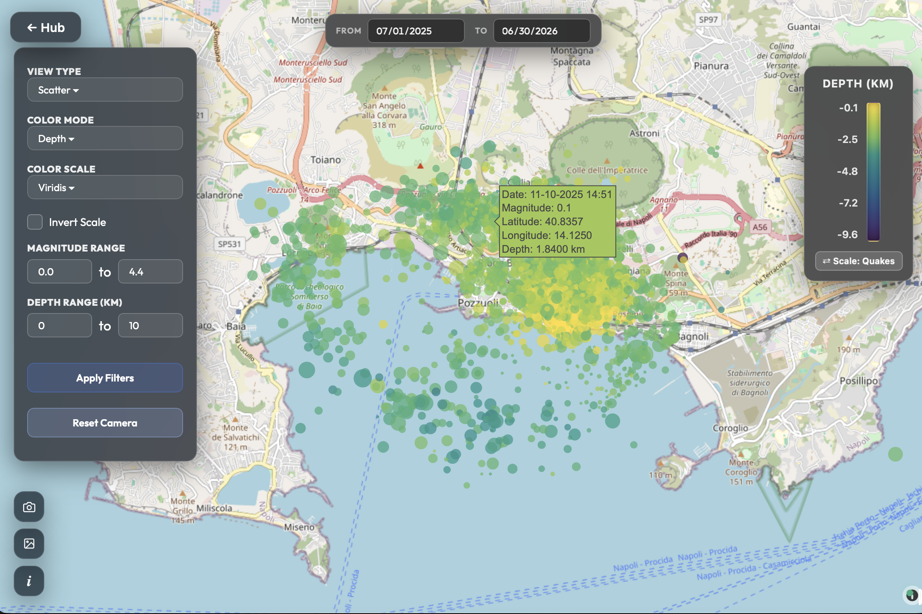
APPLICATION WORKSPACE • 2D MODE
2D Geospatial Map & In-Browser Filtering
Zero-Latency Local Filtering
Magnitude, depth, and chronological slicing processed directly in JavaScript without backend roundtrips.
Dual Layer Visualisation
Switch seamlessly between proportional scatter markers and continuous kernel density heatmaps.
Spatio-Temporal Swarm Isolation
Immediate epicentral clustering identification across Pozzuoli and Solfatara crater zones.
Notes:
[SLIDE 5 | TIME: 2:45 - 3:25 | TARGET: 40 SECONDS]
SPEECH (EN):
"Now, let's dive into the current application features, starting with the 2D Workspace.
On the left panel, users can filter the catalogue in real time by date, depth, and magnitude. All filtering runs instantly directly in JavaScript in the browser, with zero round-trip latency to the server.
Earthquakes are mapped using OpenStreetMap, with circles scaled by seismic energy and colored by hypocentral depth.
On the right, live summary cards calculate total event count, maximum magnitude, and cumulative energy release in kilojoules.
Researchers can immediately isolate swarms around Pozzuoli or the Solfatara crater."
[VISUAL ACTION: Point to the 2D map screenshot on the left and the statistical indicators on the right]

Slide 6
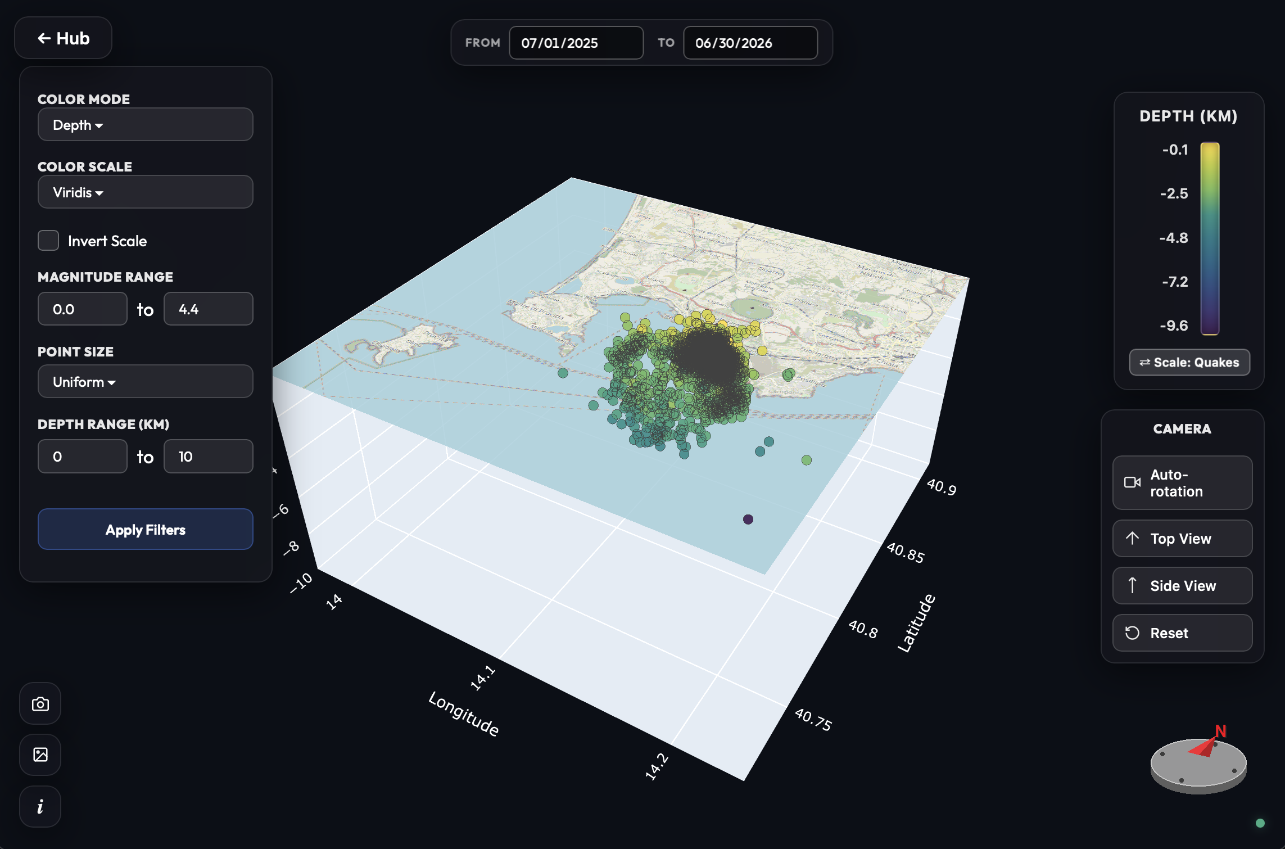
APPLICATION WORKSPACE • 3D MODE
3D Static Hypocentral Point Cloud
True Depth Scaling
Hypocentres positioned in physical kilometres beneath an OpenStreetMap surface tile mesh.
Aspect Ratio Correction
Compensates for meridional convergence using equatorial factor K = 111.32 km/° and mean latitude.
Stateful Camera Retention
Camera viewpoint preserved across filter updates via Plotly uirevision='constant'.
Notes:
[SLIDE 6 | TIME: 3:25 - 4:05 | TARGET: 40 SECONDS]
SPEECH (EN):
"Next, switching to the 3D Workspace, earthquakes are rendered in physical space using WebGL.
Now, anyone who has worked with 3D point clouds knows that depth perception on a flat screen can be tricky. To solve this, we introduced three visual cues:
First, vertical drop lines that project each hypocenter straight down to sea level.
Second, a clear depth color gradient.
And third, a 3D bounding box with depth marks in kilometers.
We also built a dynamic 3D compass in the corner that syncs with camera rotation, so researchers never lose their spatial orientation."
[VISUAL ACTION: Point out the orthographic drop lines, the depth color scale, and the 3D compass widget on the screenshot]

Slide 7

APPLICATION WORKSPACE • 4D MODE
4D Temporal Animation & Sequence Slicing
Accumulation Mode
Sliding Window
Discrete Block Mode
Shows seismic buildup from initial event to current timestamp, tracking cumulative stress release.
Moves a window of width W across time, isolating active hypocentral migration fronts.
Partitions the sequence into non-overlapping chronological chunks for comparative analysis.
Interactive Timeline Histogram & Energy Meter
Real-time playback scrubbing coupled with simultaneous cumulative seismic energy tracking (kJ) and peak magnitude readout.
Notes:
[SLIDE 7 | TIME: 4:05 - 4:45 | TARGET: 40 SECONDS]
SPEECH (EN):
"Earthquake swarms aren't static — they migrate. Our 4D Animation Engine lets researchers watch this evolution unfold over time.
Users can choose between a cumulative view, which shows seismic buildup, or a moving time window from 1 to 30 days to isolate active migration fronts.
To make fault propagation clear without cluttering the screen, we created what we call the 'Afterglow' visual effect. New earthquakes burst onto the screen bright and large, while older events exponentially fade out over time.
This lets geophysicists clearly see the direction and speed of fluid-driven fractures across the caldera."
[VISUAL ACTION: Describe the Afterglow mechanism and how it reveals fluid migration pathways over time]

Slide 8
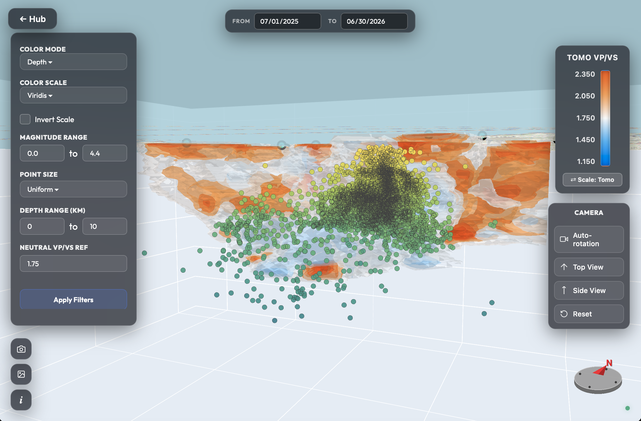
MULTI-LAYER GEOPHYSICS
Tomography, Ground Uplift & Stations
Vp/Vs Seismic Tomography
3D IDW volumetric grid (30×22×16) with Gaussian decay blending toward crustal baseline (1.75).
GNSS Ground Uplift Columns
Vertical deformation columns from GPS stations correlated with underlying swarm clusters.
Direct spatial visual alignment between deep fluid pockets and surface bradyseism.
Notes:
[SLIDE 8 | TIME: 4:45 - 5:30 | TARGET: 45 SECONDS]
SPEECH (EN):
"What really sets Seismic Viewer apart is that it doesn't just show dots in space — it fuses multiple geophysical datasets in the same 3D scene.
First, we render 3D seismic tomography. We interpolate Vp/Vs velocity ratios onto a 3D grid using Inverse Distance Weighting, applying a Gaussian spatial decay that smoothly transitions outside data points to the regional baseline of 1.75.
Second, we display surface ground deformation from GNSS satellite networks, both as station vectors and as an interpolated uplift surface with Mogi decay.
And third, we plot active seismic monitoring stations right on the surface.
By seeing these layers together, researchers can correlate high-fluid zones and surface uplift directly with where faults are breaking."
[VISUAL ACTION: Point to the tomography volume, GNSS vectors, and the multi-layer integration cards]

Slide 9
MACHINE LEARNING ENGINE
Clustering Paradigms: Why & How We Adapted Them
DBSCAN
MiniBatchKMeans
Cylinder Grid
Why chosen: Detects non-planar, arbitrary fault shapes without prior K count; isolates background noise (label -1).
Why chosen: Scalable centroid partitioning across random batches (b=1024) for instant parameter slider response.
Why chosen: Regular vertical partitioning (r=0.5 km) breaking complex geometries into planar segments.
Auto-Tuning: Radius ε* estimated from k-distance knee via Kneedle algorithm.
Adaptation: Post-distance filter (d_max) eliminates outliers forced into clusters.
Adaptation: Enforces spatial continuity across 4D animation frames.
Hierarchical Sub-Clustering & Lock Mechanism
Researchers can lock confirmed geological clusters and re-partition only unresolved swarms with refined parameters.
Notes:
[SLIDE 9 | TIME: 5:30 - 6:15 | TARGET: 45 SECONDS]
SPEECH (EN):
"Now, how do we identify faults from thousands of earthquakes? This brings us to our clustering engine, and why we made specific algorithmic choices.
Initially, in early prototypes, we used K-Means. But we quickly realized K-Means has two major flaws for seismology: it forces every single point into a cluster, and it assumes clusters are spherical balls. In reality, earthquakes form elongated planar faults surrounded by diffuse background noise.
So, we switched to DBSCAN. DBSCAN naturally finds arbitrary non-linear shapes and correctly labels background noise as unclustered outliers. To avoid making users guess the epsilon parameter, we automated it using the Kneedle algorithm on the k-nearest-neighbor distance plot.
We also kept MiniBatchKMeans with a distance cutoff filter for instant partitioning of massive datasets, and we added a 'Cluster Lock' feature, allowing geophysicists to freeze confirmed geological faults and re-cluster only unresolved swarms."
[VISUAL ACTION: Walk through why KMeans failed, why DBSCAN succeeded, and how Cluster Lock works]

Slide 10
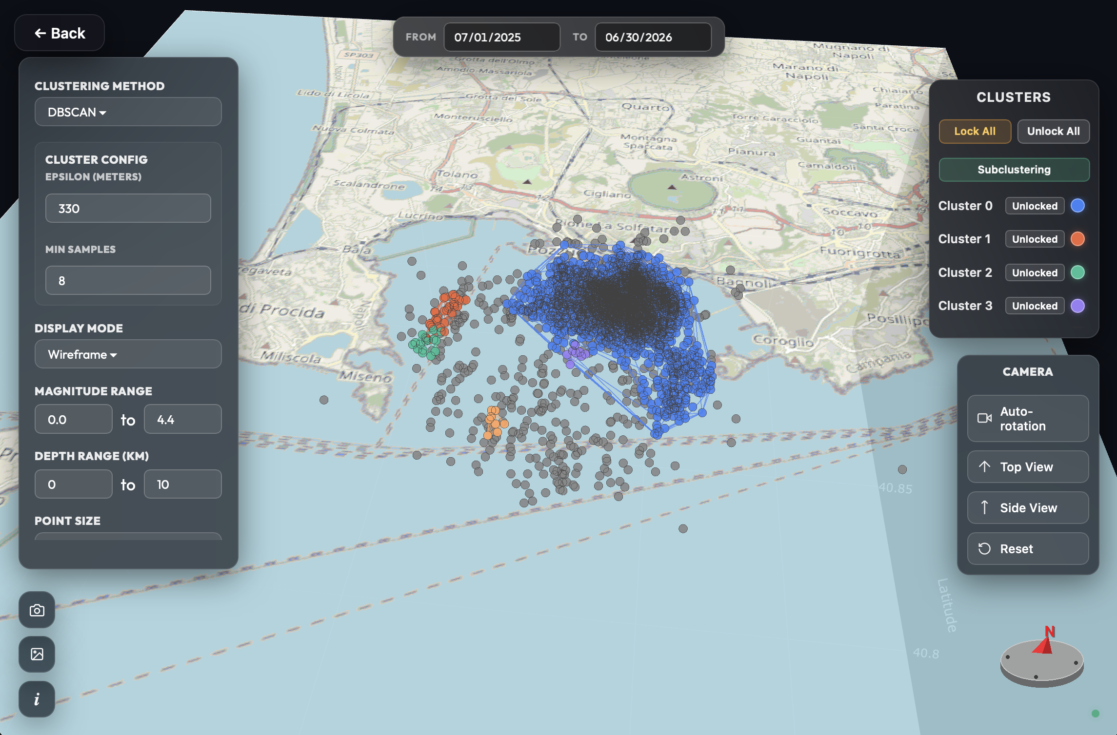
STRUCTURAL GEOLOGY & MATHEMATICS
Automated Fault Plane Estimation: RANSAC + SVD
Step 1: RANSAC Inlier Extraction
Samples triplet candidate planes over 100 iterations to eliminate diffuse non-planar noise.
Step 2: SVD & Geological Angles
Normal vector derived from smallest singular value. Computes Strike, Dip, and Planarity P = (σ₂ - σ₃)/σ₁.
Triangulated meshes display strike/dip vectors on hover inside the 3D scene.
Notes:
[SLIDE 10 | TIME: 6:15 - 7:00 | TARGET: 45 SECONDS]
SPEECH (EN):
"Once a cluster is isolated, how do we extract the physical fault plane? We designed a two-step mathematical pipeline.
Why didn't we just fit a plane using SVD directly? Because if you have even a few stray earthquakes or noise points in a cluster, ordinary least squares or direct SVD gets skewed.
So, Step 1 is RANSAC: it randomly samples point triplets over 100 iterations to find the candidate plane with the highest number of spatial inliers, discarding noise.
Then, Step 2 runs Singular Value Decomposition on the centered inliers. The normal vector of the fault plane comes directly from the eigenvector with the smallest singular value.
From this normal vector, we calculate the geological Strike, Dip, and planarity score, and render the fault as an interactive 3D wireframe mesh."
[VISUAL ACTION: Walk through RANSAC filtering -> SVD normal vector -> fitted 3D plane on the right]

Slide 11
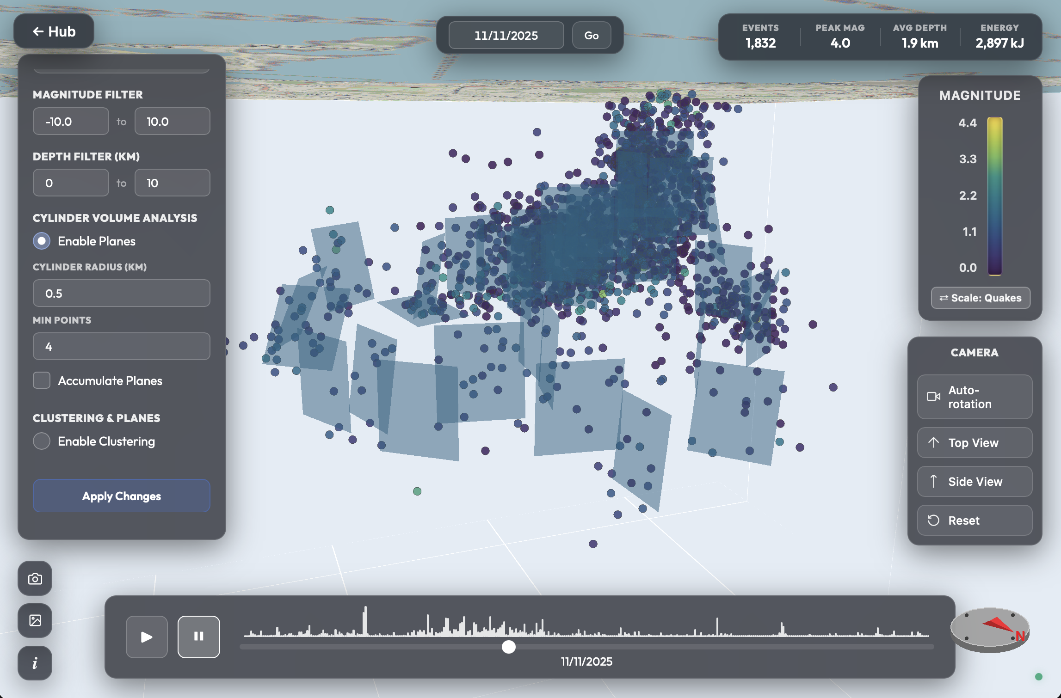
ALGORITHMIC INNOVATION
4D Cylinder Partitioning & Label Stability
Why Cylinder Partitioning?
Global 3D swarms curve across the caldera; spatial vertical cylinders isolate local linear fault segments.
Global Label Matching
Historical majority voting eliminates cluster colour flickering across sequential animation frames.
Multithreaded ThreadPoolExecutor (8 workers) fits cylinder planes in parallel across frames.
Notes:
[SLIDE 11 | TIME: 7:00 - 7:45 | TARGET: 45 SECONDS]
SPEECH (EN):
"We also solved two subtle algorithmic challenges that came up during testing.
First, caldera ring faults curve across the volcano. To handle this, we introduced Cylinder Partitioning, cutting the volume into vertical cylindrical wedges where faults are locally planar.
Second, when running clustering across 4D time steps, standard algorithms randomly reassign cluster IDs between frames. This caused colors to flicker chaotically in the animation.
To fix this, we created a Global Label Matching algorithm. For each new time frame, it takes a stochastic sample of 200 points per cluster, finds their nearest neighbors in the previous frame, and performs spatial majority voting with greedy assignment.
This keeps colors and cluster identities perfectly stable across the entire animation."
[VISUAL ACTION: Explain the color flickering problem on the left and the smooth spatial voting solution on the right]

Slide 12
DATA ENGINEERING PIPELINE
Geospatial Ingestion & Sanitisation Choices
STAGE 1 & 2
CRITICAL DECISION
STAGE 3 & 4
STAGE 5
Multi-Source Loading
Sentinel Depth Handling
Physical Bounds Check
Geospatial Projection
Dynamic CSV header alias detection and segmented yearly queries to INGV GOSSIP API.
Missing depths kept for 2D maps, but excluded from 3d/clustering to prevent artificial planes.
Filters depth [-10, +800 km], preserves volcanic mountain events, and drops future dates.
Converts UTM Zone 33N tomography grids to WGS84 and maps OSM tile coordinates.
Float32 Contiguous Binary Protocol (/api/data/{id}/bin)
-80% Size
Replaced JSON text payloads: packs coordinates into Float32Array buffers with 2-float header [N, Lc].
< 0.01 ms decode time
Notes:
[SLIDE 12 | TIME: 7:45 - 8:30 | TARGET: 45 SECONDS]
SPEECH (EN):
"Now, let's look at the data engineering pipeline and the choices we made.
The application ingests data either by querying the INGV GOSSIP REST API online, or through local CSV files. It handles coordinate conversion, date parsing, and metadata cleaning.
Here, we made a crucial design choice regarding missing depths: earthquakes with null or missing depth are kept in the 2D catalogue for completeness, but they are strictly excluded from 3D and 4D spatial computations. Otherwise, they would artificially flatten onto sea level at depth zero and corrupt fault plane fitting.
Furthermore, to avoid sending bulky JSON over the wire, we built a Float32 binary streaming protocol.
Instead of parsing thousands of JSON objects, the server streams a raw, contiguous Float32 binary buffer directly into a JavaScript typed array. This slashed payload size by nearly 80% and dropped browser unpacking time from 40 milliseconds to less than 0.01 milliseconds."
[VISUAL ACTION: Point to the data pipeline steps and highlight the 80% compression and instant parsing]

Slide 13
RESULTS & QUANTITATIVE VALIDATION
Benchmarks: Accuracy, Throughput & Scaling
Synthetic Monte Carlo Validation (500 runs)
Serialization & Memory Footprint
Evaluated plane extraction under Gaussian noise σ ∈ [10, 100] m and up to 30% uniform outlier contamination.
Payload reduction: 4.75 MB JSON vs 976 KB Float32 (-79.4%).
Browser parse time: Dropped from 39.7 ms to < 0.01 ms.
< 0.51°
< 0.93°
Bounded memory: FIFO stores hold RAM strictly under 500 MB.
Dip MAE (100m noise)
Strike MAE (100m noise)
Real Catalogue Testing (Campi Flegrei)
Algorithmic Throughput
Tested on 3,225 INGV events (2014–2024) and stress-tested up to 50,000 synthetic hypocentres maintaining 55–60 FPS.
Cylinder grid partitioning executes in 36.5 ms and MiniBatchKMeans in 301 ms for 50,000 hypocentres.
Notes:
[SLIDE 13 | TIME: 8:30 - 9:15 | TARGET: 45 SECONDS]
SPEECH (EN):
"To validate the system, we carried out extensive benchmarks:
First, in Monte Carlo simulations across 500 synthetic faults with noise and 30% random outliers, our RANSAC-SVD method achieved a Mean Absolute Error under 0.5 degrees for Dip, and under 0.9 degrees for Strike.
Second, on the real Campi Flegrei catalogue of over 3,200 earthquakes, clustering and plane fitting completed in less than 42 milliseconds.
Third, in stress tests with 50,000 synthetic hypocenters, WebGL maintained a smooth 55 to 60 frames per second.
And memory management benchmarks confirmed that our session caching and garbage collection keep RAM usage strictly below 500 megabytes throughout extended sessions."
[VISUAL ACTION: Point to the validation metrics in the table: Monte Carlo MAE, 42ms clustering, 60 FPS stress test]

Slide 14
SAPIENZA UNIVERSITY OF ROME
Conclusions & Future Work
Validated Contributions
Future Extensions
Unified desktop architecture delivering 4D visualization, machine learning clustering, and automated fault plane extraction with sub-second response times.
Live SeedLink streaming for seismic surveillance rooms, focal mechanism tensor solutions, Coulomb static stress transfer maps, and Deck.gl WebGL rendering.
Thank you for your attention
Faculty of Information Engineering, Computer Science and Statistics
Alessio Curcio • alessio.curcio04@gmail.com
Notes:
[SLIDE 14 | TIME: 9:15 - 9:40 | TARGET: 25 SECONDS]
SPEECH (EN):
"In conclusion, Seismic Viewer delivers a lightweight, accessible, and fast tool that bridges the gap between raw seismological data and interactive 3D and 4D exploration.
It was developed and validated in close collaboration with INGV researchers to directly support volcano monitoring.
Looking ahead, future improvements will focus on real-time WebSocket push notifications from INGV feeds, WebGPU shaders for on-the-fly clustering, and focal mechanism beachball inversions.
Thank you very much for your time and attention. I would be glad to answer any questions."
[VISUAL ACTION: Thank the committee and supervisors, open the floor for Q&A at exactly ~9m 40s]

